Slide 1
Social Context of Computing

Slide 2
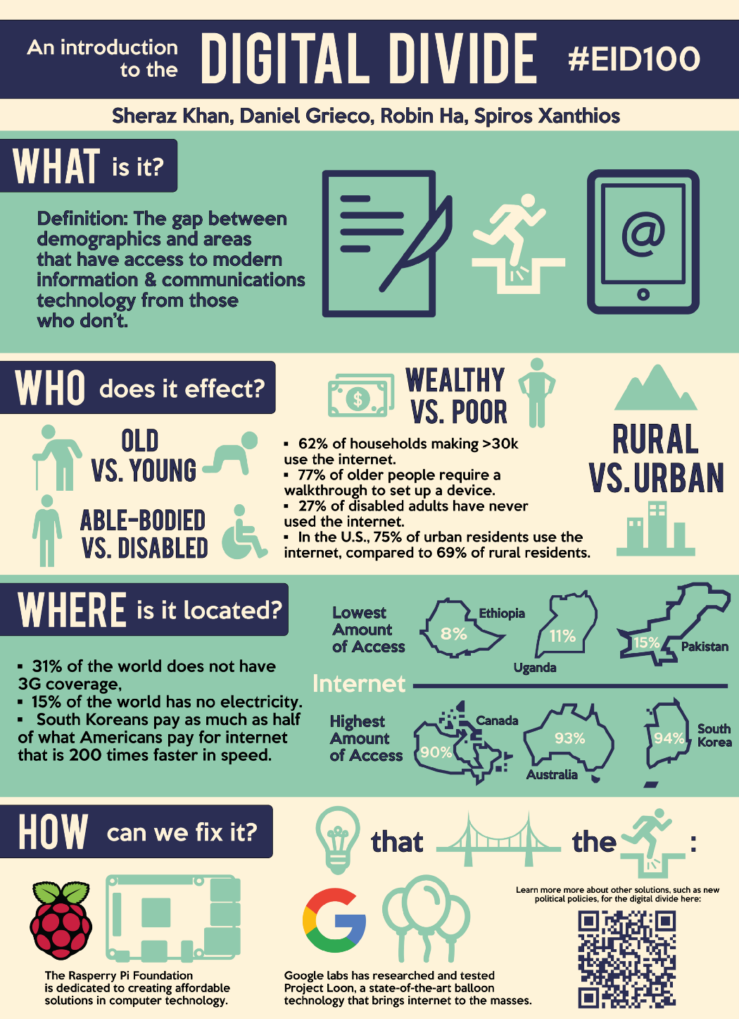
Digital Divide

Slide 4
What Is the Digital Divide?
the digital divide is the gap between those with Internet access and those without it. But the digital divide is multifaceted and includes many factors such as access, affordability, quality, and relevance. As Michael Kende wrote, “the digital divide is not a binary.” Here are some of the things that lead to disparities in Internet access:
Availability: Is there available access to the Internet in your area?
Affordability: Is that access affordable?
Quality of service: Are the upload and download speeds sufficient
Relevance: Does the connected community have the necessary skills and technologies?
Additional divides: Other areas that can create digital inequality include security, interconnectivity, digital literacy, and access to equipment.

Slide 5
What is the digital divide today?
According to studies and reports, the digital divide is still very much a reality today. According to a 2019 report, approximately 5 million rural American households and 15.3 million urban or metro areas still don't access broadband internet.
Meanwhile, a study by the Pew Research Center noted that 24% of adults with household incomes below $30,000 a year don't own a smartphone and 40% of those with lower incomes don't have home broadband services or a computer.
Globally, the digital divide in developing countries includes a lack of access to digital technology and internet service. It can also include a lack of accessibility to modern, high-quality new technologies such as mobile phones and Wi-Fi access.

Slide 6
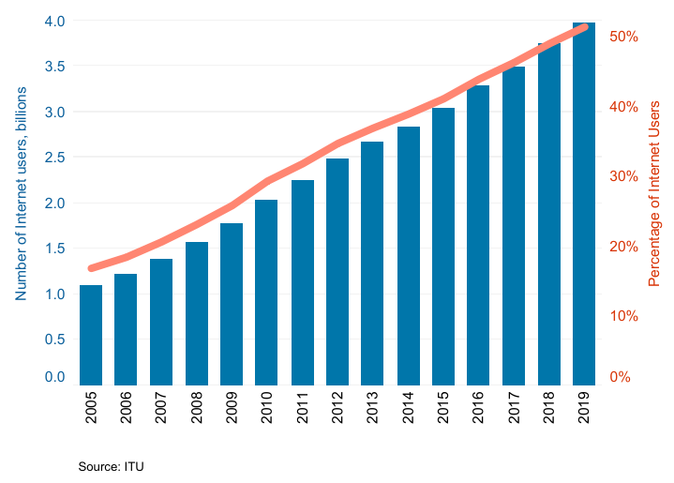
The Latest Data on Digital Divide
The UN’s Broadband Commission for Sustainable Development estimates that nearly 3.6 billion people remain totally unconnected to the Internet by any measure. This means there are around 4.1 billion people online, about 53.6% of the global population.

Slide 7
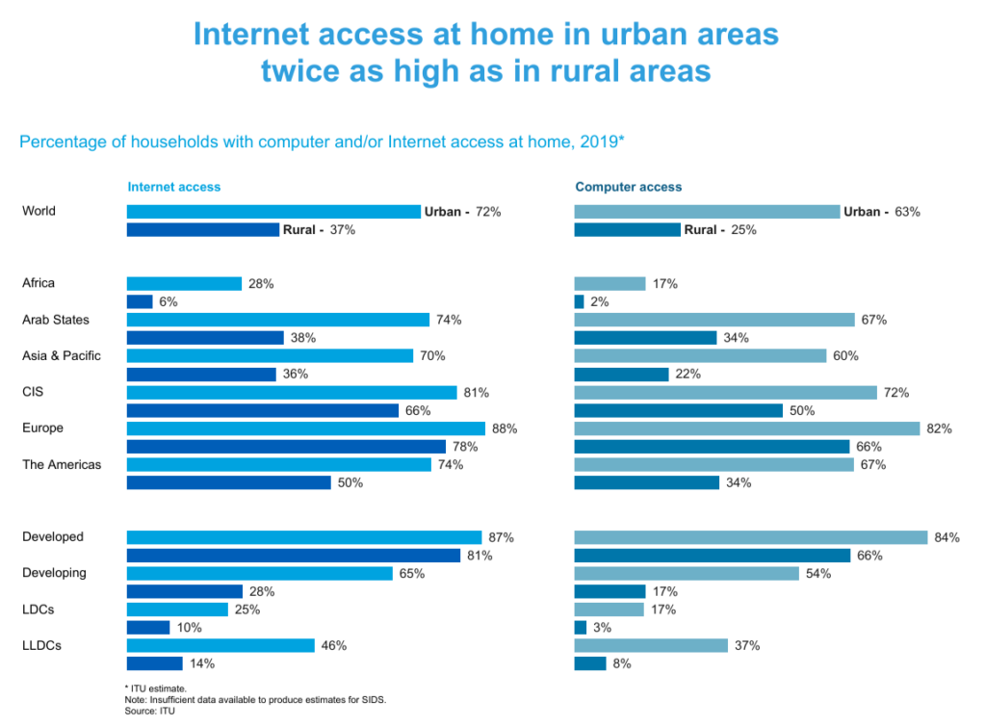

Slide 8
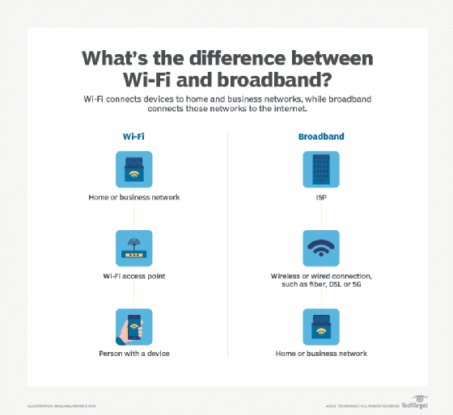

Slide 9
The Digital Divide Exacerbates Other Divides
Digital exclusion has many adverse impacts. Here are a few:
Access to healthcare and its outcomes: Internet access is an important public health issue. Lack of access means exclusion from vital health information and resources.
Economic opportunities: For both workers and business owners, lack of quality broadband means decreased economic opportunities and competitiveness in the digital economy.
Educational opportunities: Lack of Internet access for school-aged children means that they are denied the educational benefits of the Internet.

Slide 10
Community Networks Are One Complementary Solution for Bridging the Digital Divide
Community networks can meet the challenges of the many digital divides, bringing affordable Internet access to those who need it the most. Beyond making the Internet available and affordable, community networks help address some of the other divides mentioned above.
For instance, bringing Internet access to a community improves health disparities by making affordable telehealth options available to rural areas—this was the outcome of the Internet Society’s Nepal’s initiative Effective Broadband for Health. Other communities have seen changes in different areas at once through connectivity, such as education, healthcare, and agriculture in the case of the Murambinda community network in Zimbabwe.
The community network deployment process also shows that community members who are involved in building their networks also strengthen their shared digital literacy skills.

Slide 11
Bridging the digital divide
Proponents for bridging the digital divide include those who argue it would improve digital literacy, digital skills democracy, social mobility, economic equality and economic growth.
The United Nations, for example, has helped to raise awareness regarding the global digital divide through the yearly celebration of World Information Society Day. It has also created the Information and Communication Technologies Task Force in an effort to bridge the global digital divide.
However, overcoming the digital divide has not gotten easier, particularly in the aftermath of the COVID-19 pandemic.
A 2020 McKinsey report stated that learning loss will only increase as educators and students have taken to remote learning and internet usage from home is required by low-income families who may not have access to the right technology.

Slide 12
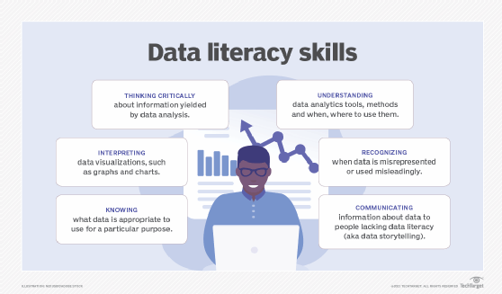

Slide 13
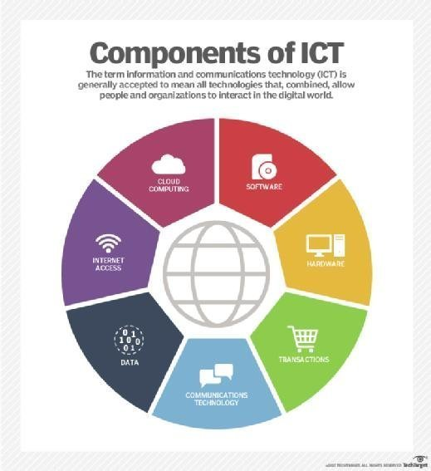

Slide 14
What Is an Electronic Office?
An electronic office is an office or work environment that is utilizing electronic methods of storing and using documents over using paper.
Also known as an e-office, an electronic office is a term that refers to any office environment that makes significant use of computer technology to operate.
Today, an electronic office is more commonly equated with the virtual office, which involves the use of wireless technology to allow people to work from virtually anywhere with the right type of laptop or notebook and a reliable wireless connection.

Slide 15
ICT in the workplace
Computers and internet access have transformed the way many people work:
businesses rarely produce written letters or reports or use typewriters any more
documents are more likely to be sent by email than by post or fax
employees with laptops or smartphones can work from home or while they travel
There are positives to an employee having a computer, especially one with internet access:
use of email, instant messenging online collaboration tools and video conferencing to interact with colleagues and clients
access a host of information online to help with research-related tasks
easily share and collaborate on documents

Slide 16
Relevance of Information Communication Technology at Work
Ease of Communication and Collaboration
Ensures Employee Productivity and Industry Efficiency
Maintains Organization and Accuracy
Data Security and Safety
Higher employee productivity and satisfaction.
The ability to better serve customers.
Increased Collaboration
Improved Cost Management

Slide 17
Disadvantages
The internet is full of distractions and employees may prefer to play games, browse and update social networking sites or reply to personal emails and instant messages than to get on with their work.
Employers are aware of this and often block access to certain websites. These restrictions may be relaxed during lunchtime or outside of working hours.

Slide 18
What is Virtual Workplace
A virtual workplace is a workplace that is not located in any one physical space; rather, several workplaces are technologically connected (via the Internet) without regard to geographic boundaries. Employees are thus able to interact and work with one another in a collaborated environment regardless of where they are in the world.
A virtual workplace decreases unnecessary costs by integrating technology processes, people processes, and online processes

Slide 19
Benefits of Virtual Workplace
Eases the transition to remote work.
No physical office space means lower costs.
More market opportunities and higher profits.
Environment-friendly. Since employees don’t need to commute anymore, lower emissions result.

Slide 20
The impact of ICT on society
Working from home
Many employers give their workforce the option to be based at home. A secure internet connection provides access to the company’s network, shared files, email and printers.
Employees can use the company’s email system to keep in touch with the office. There are also a number of other ways of communicating. They can:
divert their office phone to their mobile phone or smartphone
browse the intranet to keep up to date with company developments
take part in meetings using video conferencing

Slide 21
Advantages
for the employee
No travel costs or time wasted travelling to and from work
Working in the comfort of their own home
Option to work for a company hundreds or even thousands of miles away
Able to spend more time with their family
for the employer
No need to provide employee with a desk or computer if they choose to use their own
Overhead cost savings with remote work
Employee may be happier working from home and do more work as a result

Slide 22
Disadvantages
for the employee
It can be lonely working from home and they may not feel part of a team
There are arguably more distractions at home than in the office
It may prove difficult to separate work from home life
for the employer
Harder to check what employee is up to
Employee may not feel part of a team and might end up doing less work

Slide 23
What is monitoring in the workplace?
“Employee monitoring” refers to the methods employers use to surveil their workplaces and their staff members’ where abouts and activities. These methods include employee monitoring software, time clocks, video surveillance, GPS systems and biometric technology. Video surveillance, for example, can strengthen your business’s security and productivity. Catching a thief on camera certainly reduces shrinkage costs.
Employee tracking and monitoring systems serve other important purposes. Their main goals are to prevent internal theft, examine employee productivity, ensure company resources are being used appropriately, and provide evidence for any potential litigation.

Slide 24
Advantages for Employees
"Electronic monitoring offers a distinct advantage to the employee: it is objective”. This is a benefit because it provides an unbiased method of performance evaluation and prevents the interference of managers' feelings in an employee review.
Electronically-generated information offers uniform and accurate feedback on past performance. Thus, the evaluation will be solely based on the quantity and quality of an employee's work, rather than on managers' opinions.

Slide 25
Disadvantages for Employees
Although the advantages are important and helpful to employees, the disadvantages that go along with employee monitoring may outweigh the benefits. While employers argue that monitoring is an inexpensive way to increase productivity and customer service, others argue it is really the modem method of exerting control and power over labor.
Monitoring has been used to determine pay and promotion decisions as well as to reinforce disciplinary actions.
Objections to computer monitoring include the issue of privacy. Monitoring is intrusive and the potential for abuse exists. For example, computer data banks, telephone and video monitoring, active badges, and other monitoring techniques make the private lives of workers easier to delve into without detection. Data concerning employees' security clearance, computer applications preferred, right/left handedness, and "even how the user takes his coffee" can be maintained -- which go beyond how an employee is performing on the job

Slide 26
Ergonomics
Ergonomics is defined as the applied science of equipment design, as for the workplace, intended to maximize productivity by reducing operator fatigue and discomfort. In simple language this means fitting the job to the people who have to do it, through the design of equipment and procedures. Ergonomics may also be referred to as biotechnology, human engineering, and human factors engineering.

Slide 27
The word ergonomics comes from the Greek word “ergon” which means work and “nomos” which means laws. It’s essentially the “laws of work” or “science of work”. Good ergonomic design removes incompatibilities between the work and the worker and creates the optimal work environment.
Ergonomics draws on many disciplines to optimize the interaction between the work environment and the worker.

Slide 28
Why computer ergonomics?
Many people spend hours a day in front of a computer without thinking about the impact on their bodies. They physically stress their bodies daily without realizing it by extending their wrists, slouching, sitting without foot support and straining to look at poorly placed monitors.
These practices can lead to cumulative trauma disorders or repetitive stress injuries, which create a life-long impact on health. Symptoms may include pain, muscle fatigue, loss of sensation, tingling and reduced performance.
Ergonomics is a field of study that attempts to reduce strain, fatigue, and injuries by improving product design and workspace arrangement. The goal is a comfortable, relaxed posture.

Slide 29
Types of Ergonomics
There are three types of ergonomics: physical, cognitive, and organizational.
Physical Ergonomics
Physical ergonomics is the most commonly known form of ergonomics, and for good reason. It deals with the physical load on the human body when performing activities. Understanding physical ergonomics and how to integrate it heavily influences on-site safety.
Cognitive Ergonomics
Cognitive ergonomics is the method of designing and arranging information and data to create a light cognitive load.
Perception, memory, reasoning, and motor response all affect how someone interacts with and performs their work. A higher cognitive workload causes more stress on the worker.
Organizational Ergonomics
Organizational ergonomics combines the knowledge gained from other areas of the factory, like physical and cognitive ergonomics, to optimize safety and efficiency across the entire organization.

Slide 30
3 Ways Poor Office Ergonomics Can Hurt Your Health
Vision Problems
Back and Neck Pain
Wrist, Hand and Shoulder Pain

